Slide 1
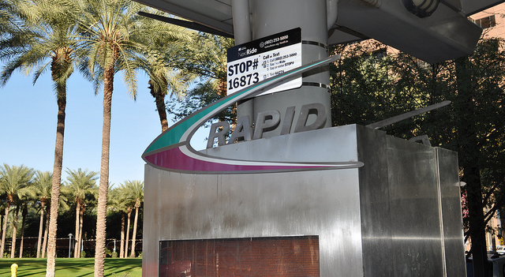
Nanotechnology to speed up mobility (future)

Slide 2
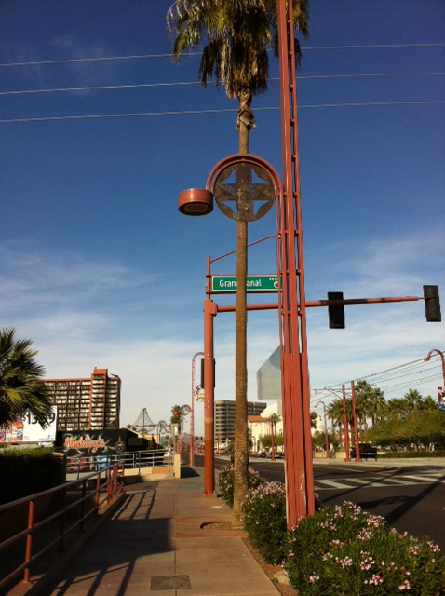
A totem or just a pole?
(past)

Slide 3
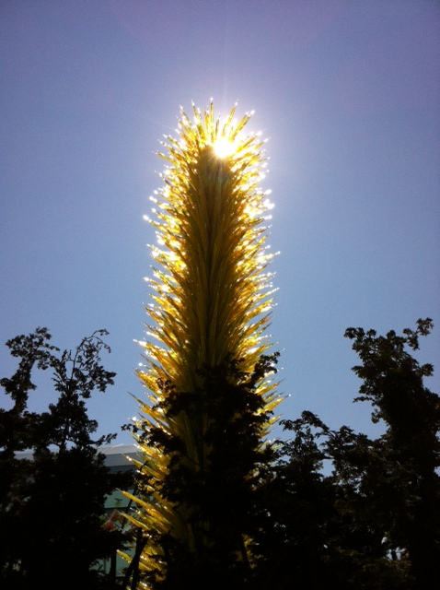
The fragility of solar power (future)

Slide 4
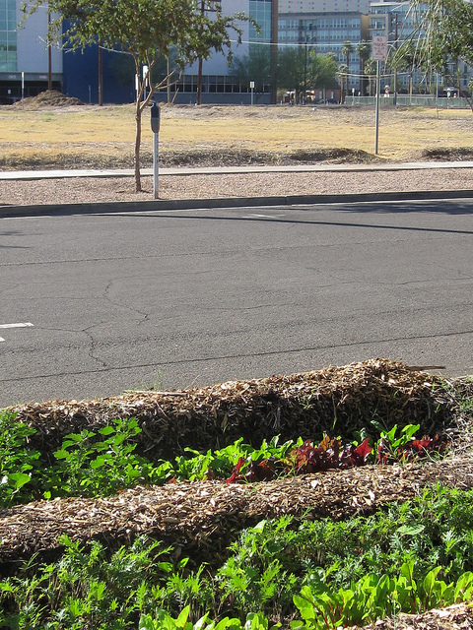
Sidewalk garden vs. empty lot
(present)

Slide 5
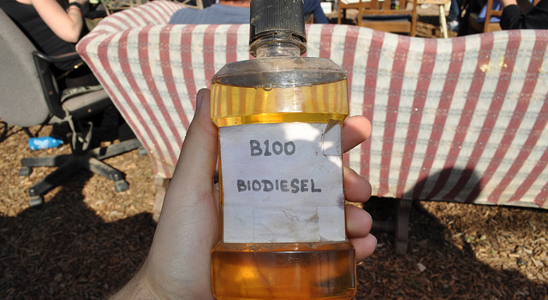
Smells like french fries
(present)

Slide 6
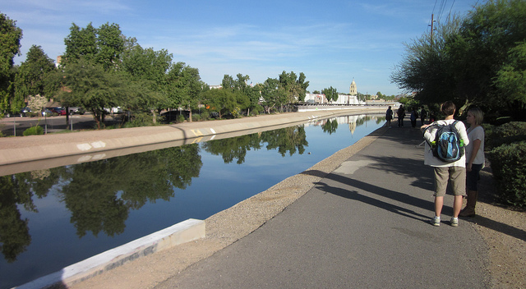
The city’s lifeblood (past)

Slide 7
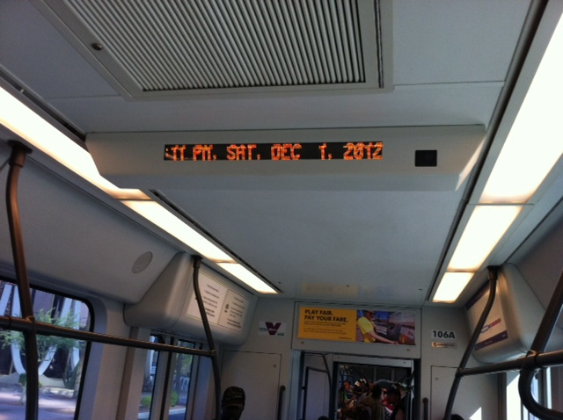
Air-conditioned metro (present)

Slide 8
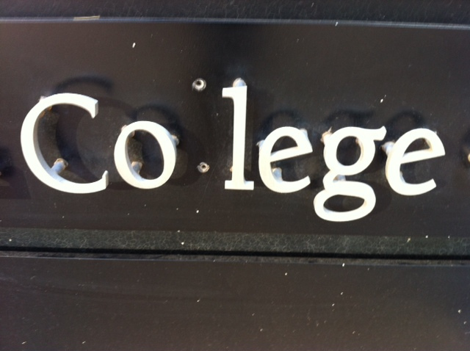
Something missing in higher ed (present)

