Slide 1
Futurescape City Tours
Recruitment &
Pre-planning

Slide 2
RECRUITMENT
Who do we want to reach?
Based on the objectives of the FCT, Recruitment Strategy should take into account:
Diversity!
Socio-demographic context
Geographic context
Civic participation
W8 W7 W6 W5 W4 W3 W2 W1
http://cns.asu.edu/fct/tour-implementation/pre-planning
Notes:
(Timeline indicating weeks for FCT)
Who do we want at the FCT?
Recruitment depends on the objectives of the tours: Policy makers/decision-makers or lay citizens? Or both? FCT is intended for the general public(s).

Slide 3
RECRUITMENT
Two months before FCT orientation session takes place:
Flyer design (printed & digital versions)
’13 Website on CNS pages with background, resources, application survey, etc. (Example: http://futurescapecitytours.weebly.com/)
Distribution of flyers and invitations to participate to:
Neighborhood organizations
Non-profits
Newspapers, journals, universities, email list-servs, libraries, museums, social networks, cultural centers, etc.
W8 W7 W6 W5 W4 W3 W2 W1
http://cns.asu.edu/fct/tour-implementation/pre-planning
Notes:
Are we designing websites for every site? We have a general with links to each local site?

Slide 4
Notes:
Flyer

Slide 5
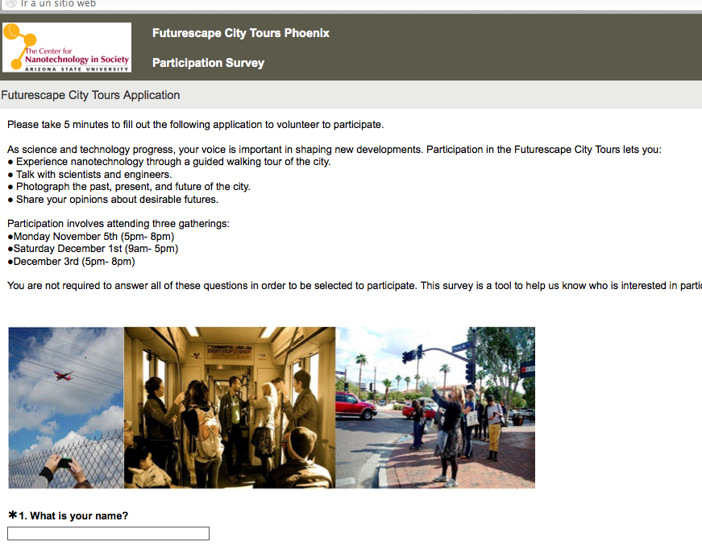
Application
Flyer directs potential participants to an online survey for your site (CNS-ASU SurveyMonkey account)
Survey collects information on:
Contact &Demographic info.
Civic involvement, interests in (nano) technology, hobbies, employment, etc.
W8 W7 W6 W5 W4 W3 W2 W1
http://cns.asu.edu/fct/tour-implementation/pre-planning

Slide 6
SURVEY QUESTIONS
A mix between Y/N, open-ended & multiple choice questions:
Age, gender | Profession
Ethnicity | Relation with nano in their profession
Religious affiliation | Main hobbies
Household income per year | Level of interests on S & T issues
Educational level | Familiarity with nano
Employment status | Civic involvement
W8 W7 W6 W5 W4 W3 W2 W1
http://cns.asu.edu/fct/tour-implementation/pre-planning

Slide 7
IRB documentation
CNS will acquire IRB approval for major sites but partners should abide by their university’s requirements.
Individual researchers will be added to the CNS IRB (CITI training and extra documentation required)
W8 W7 W6 W5 W4 W3 W2 W1
http://cns.asu.edu/fct/tour-implementation/pre-planning

Slide 8
Logistics
Reserve rooms for 1st and 3rd session
Movable, round tables
Wall space
Projector
Accessible via public transportation (downtown?)
Windows? Room décor?
Arrange food
Consider local establishments
Ask for dietary options
Parking/Public Transportation vouchers

Slide 9
Selection of Participants
SurveyMonkey transfers all survey data into an Excel spreadsheet.
The main parameter used for selecting participants is diversity, prioritizing on demographic balance (age, education, income, gender, ethnicity).
Most likely, applicants will engage regularly in civic life.
Number of participants selected: 15 to 20.
W8 W7 W6 W5 W4 W3 W2 W1
http://cns.asu.edu/fct/tour-implementation/pre-planning

Slide 10
Selection of Participants
Letter of acceptance to selected participants with information on:
Dates and place (Orientation session / Tour / Closing session / Gallery show (optional))
Confirmation of acceptance deadline
Brief overview and preparation for the Orientation Session:
Think about 3 examples of technological change you’ve experienced in your life time.
Think about 3 things you are concerned or excited about the future of your city.
Link to the website
W8 W7 W6 W5 W4 W3 W2 W1
http://cns.asu.edu/fct/tour-implementation/pre-planning

Slide 11
Selection of Participants
Letter of rejections to non-selected applicants with information on:
Different public engagement initiatives and activities (CNS & partner sites)
Invitation to attend the final gallery exhibition
W8 W7 W6 W5 W4 W3 W2 W1
http://cns.asu.edu/fct/tour-implementation/pre-planning

Slide 12
CHECKLIST for Pre-Planning before Session I
What | When?
Flyer design | W8
Website design | W8
List of identified stakeholders, community organizations, community gathering sites for marketing strategy. | W8
CNS-IRB and IRB approval | W8-W7
CITI training for CNS requirements | W8-W7
Logistic planning for Orientation and Closing sessions: secure space, parking, materials, food. | W6
Survey analysis and selection of participants | W3
Letters of acceptance & rejection | W2
Secure space for gallery exhibition | W2
http://cns.asu.edu/fct/tour-implementation/pre-planning

