Slide 1
FutureScape City Tours Process
1) Orientation Session
  Citizen-driven and emergent agenda
  Energy, Transportation, and Water
2) Tour
  Walking Tour
  Integration between “experts” and citizens
  Varieties of techniques/structures for participation (beyond deliberation)
  Emphasis on past, present, and future
3) Closing Session
  Material Deliberation
4) First Friday Exhibition

Slide 2
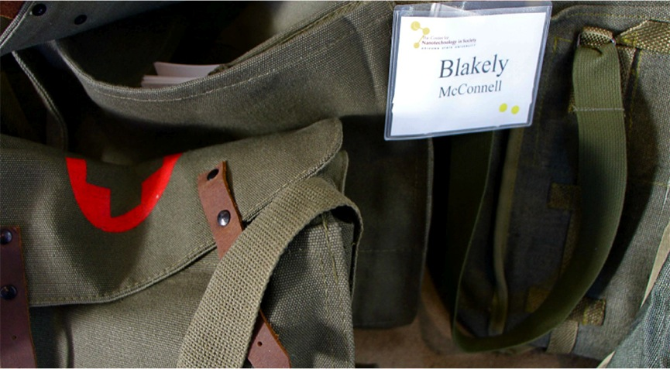
Bags

Slide 3
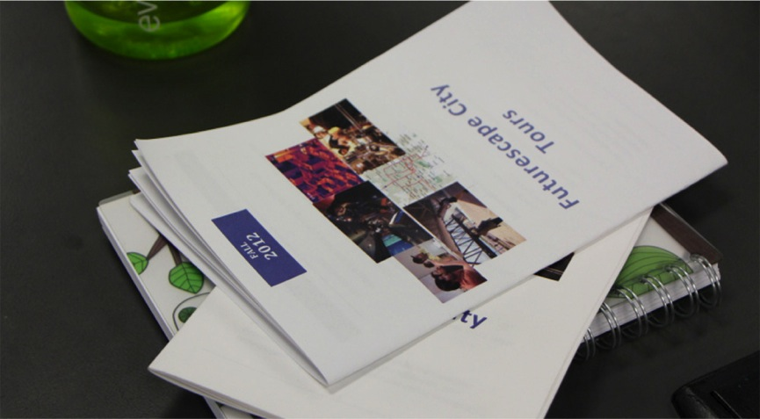
Workbooks

Slide 4
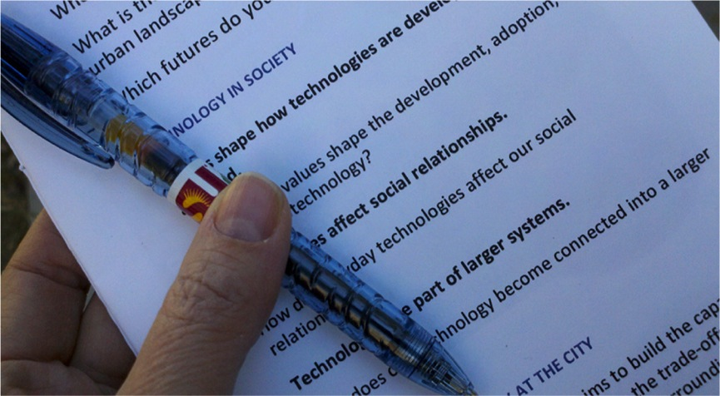
Artifact of systems thinking, disciplined intentionality

Slide 5
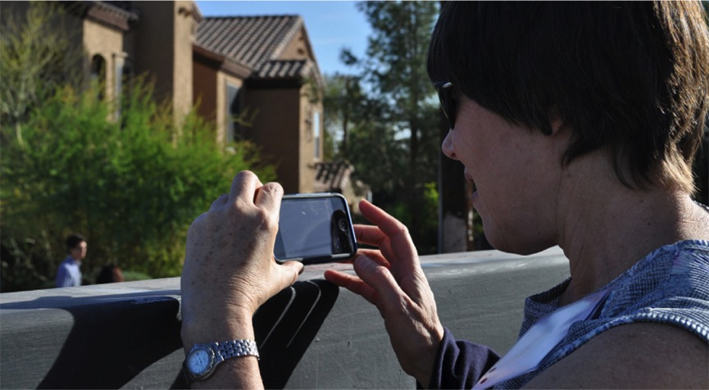

Slide 6
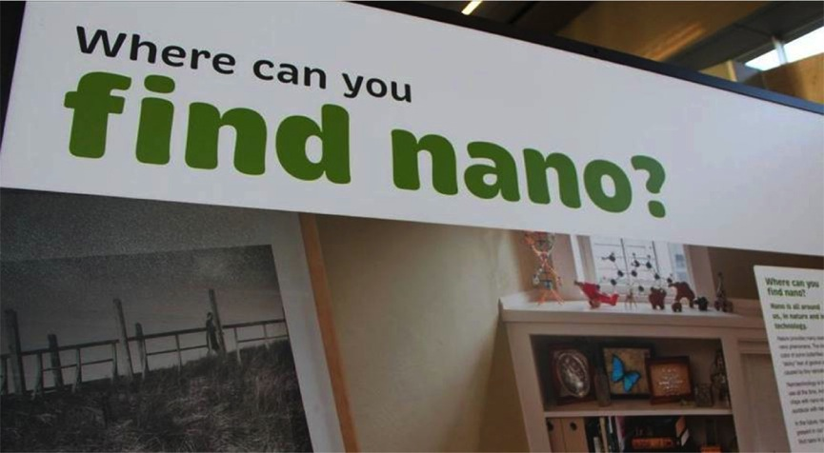
The Tour Begins…

Slide 7
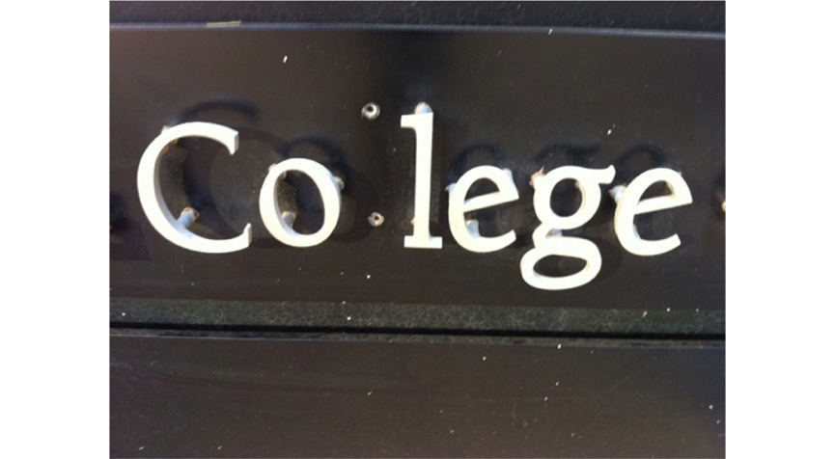
Something missing in higher ed (present)
Notes:
Use of Photography
Guidebook
Additional instruction necessary
Examples…

Slide 8
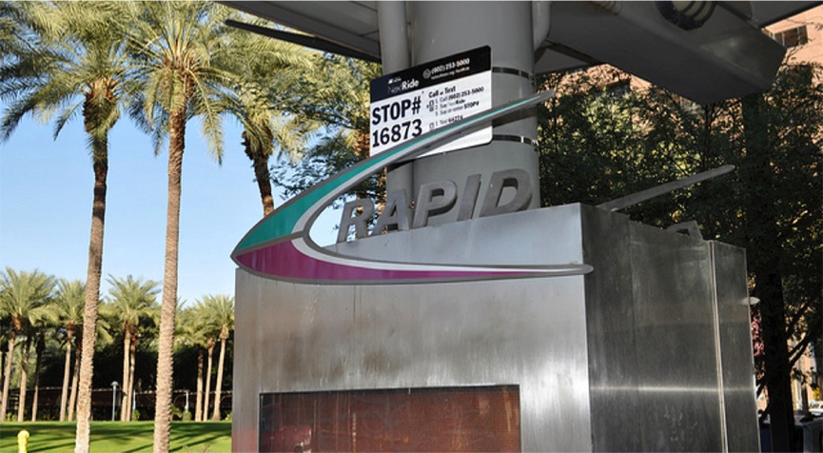
Nanotechnology to speed up mobility (future)
Notes:
SITE SPECIFIC

Slide 9
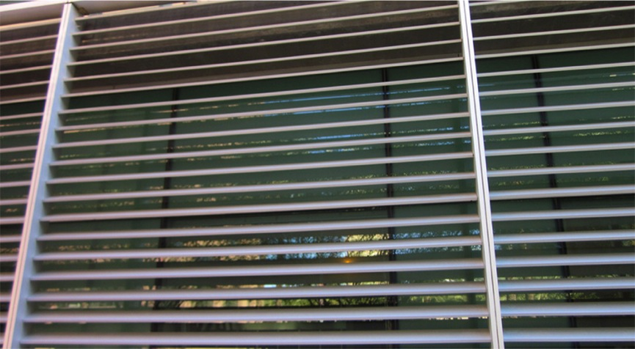
Shade (present)
Notes:
Place specific

Slide 10
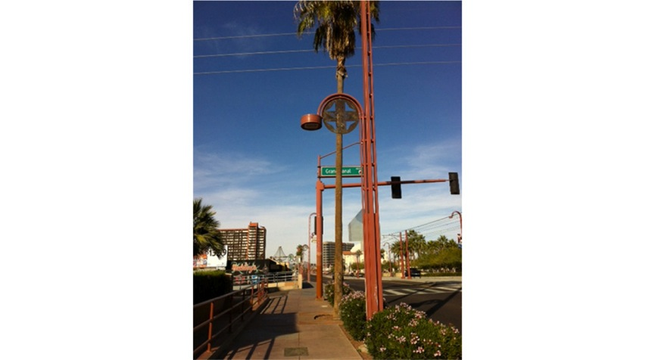
A totem or just a pole?
(past)

Slide 11
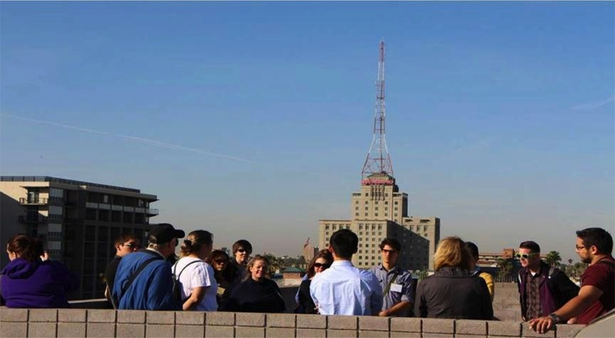
Solar- Biosciences High School

Slide 12
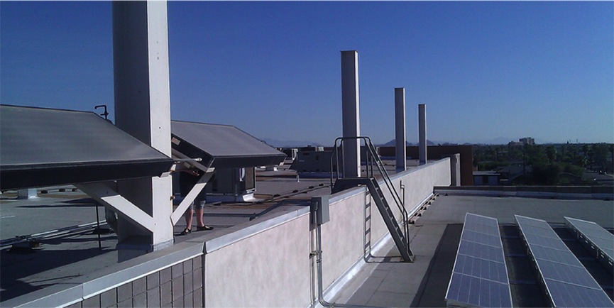
more businesses and institutions seek alternate and more efficient operating methods (future)

Slide 13
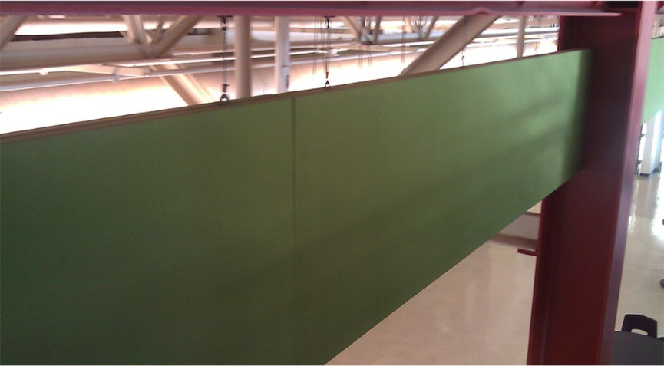
building construction methods- this system used to alter how sound travels within this space (present)

Slide 14
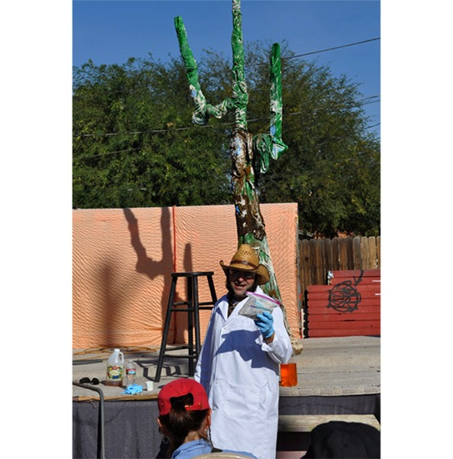

Slide 15
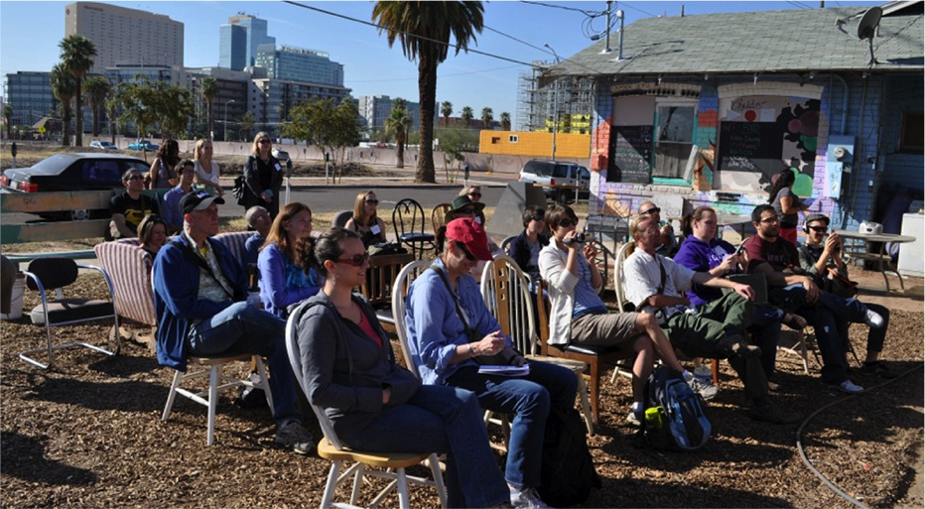

Slide 16
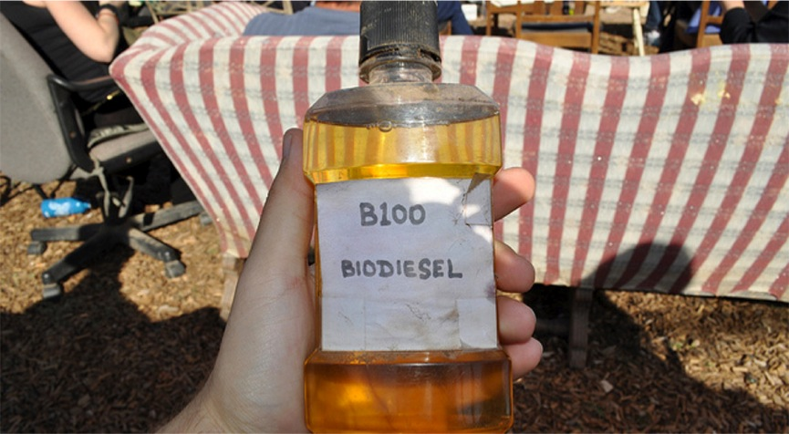
Smells like french fries
(present)
Notes:
Biofuel- a demonstration

Slide 17
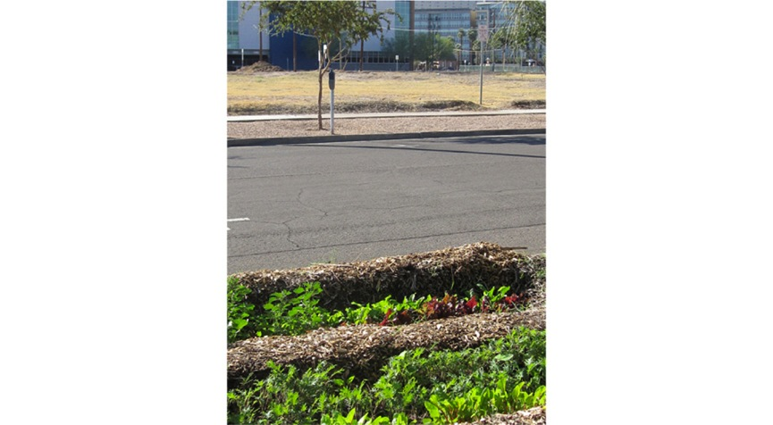
Sidewalk garden vs. empty lot
(present)

Slide 18
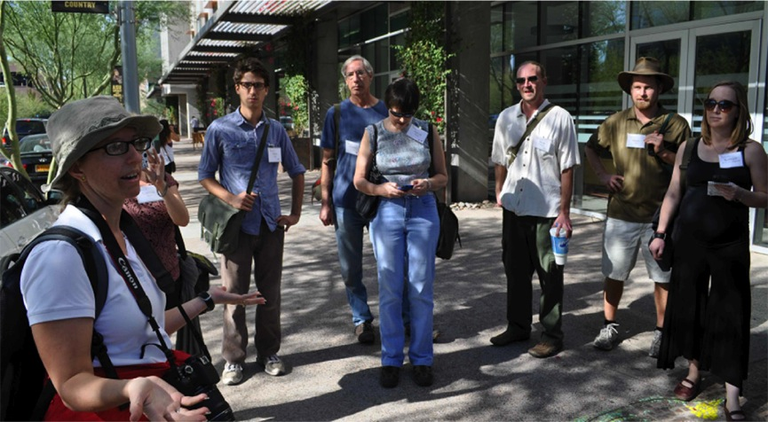

Slide 19
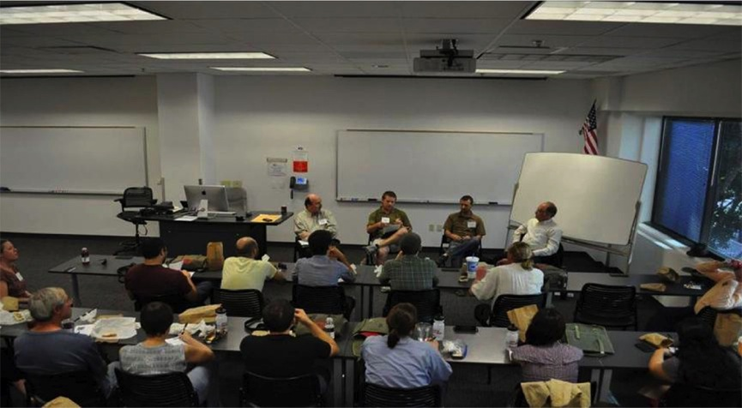
Transportation- Variety of Participation Tools & Techniques

Slide 20
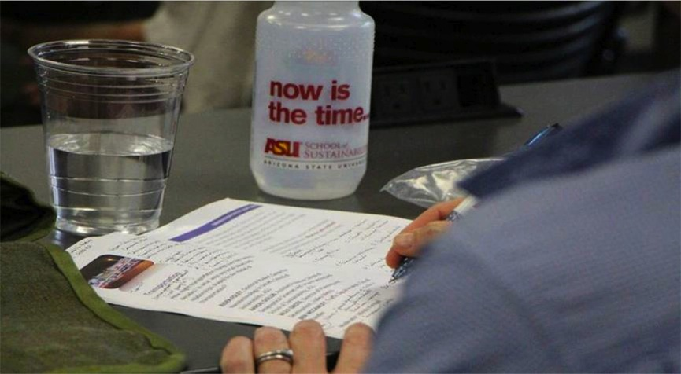
Reflecting Writing

Slide 21
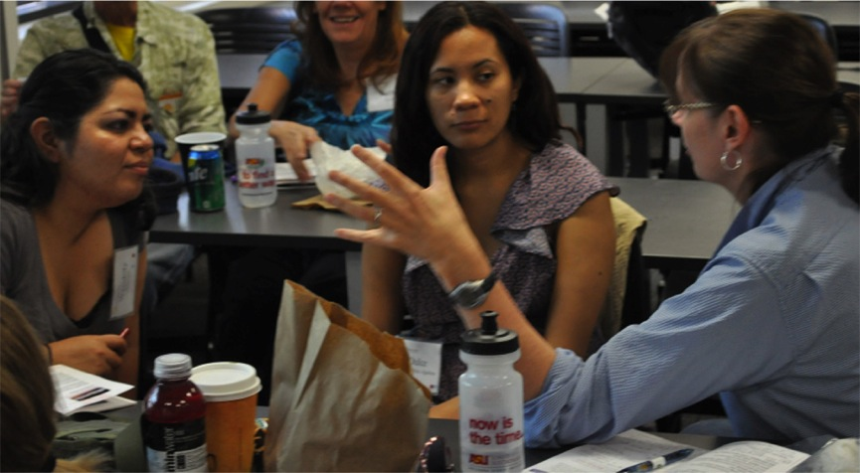

Slide 22
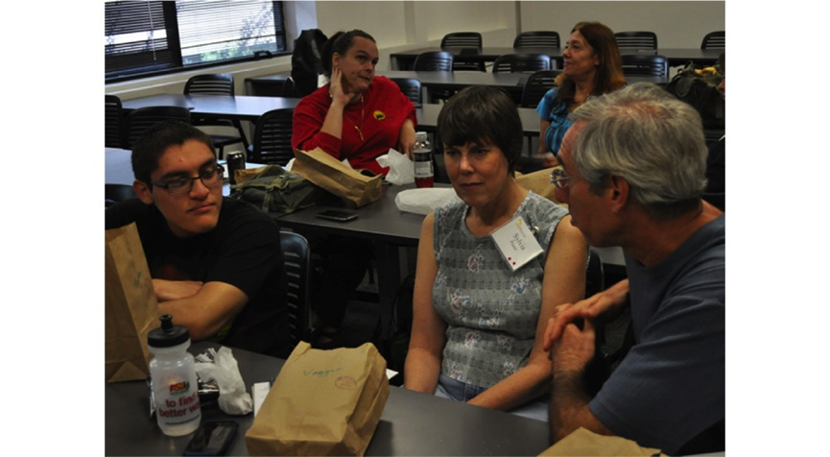

Slide 23
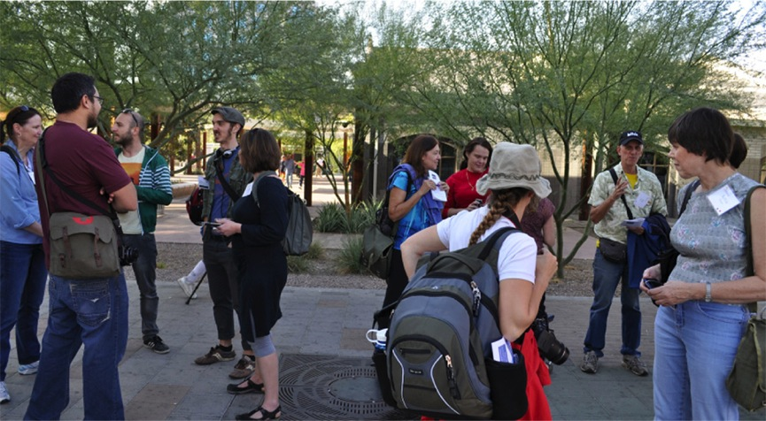

Slide 24
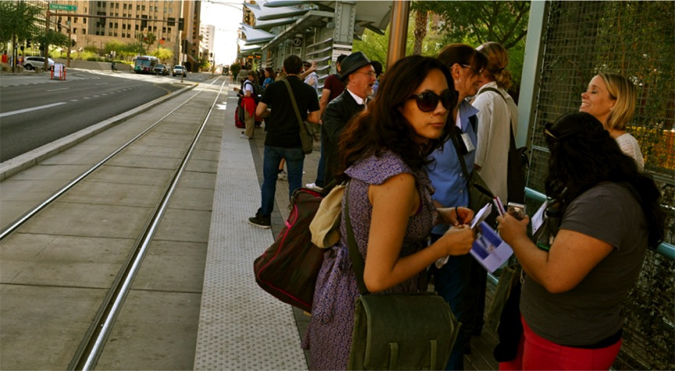

Slide 25
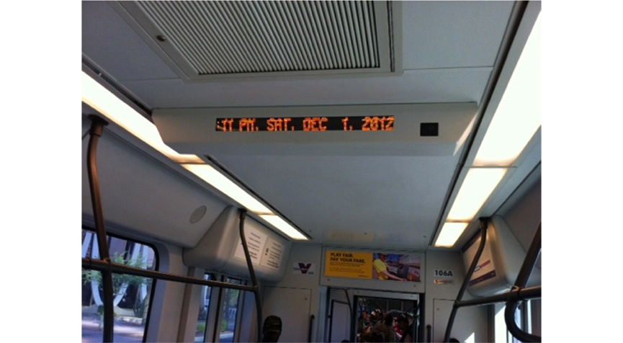
Air-conditioned metro (present)

Slide 26
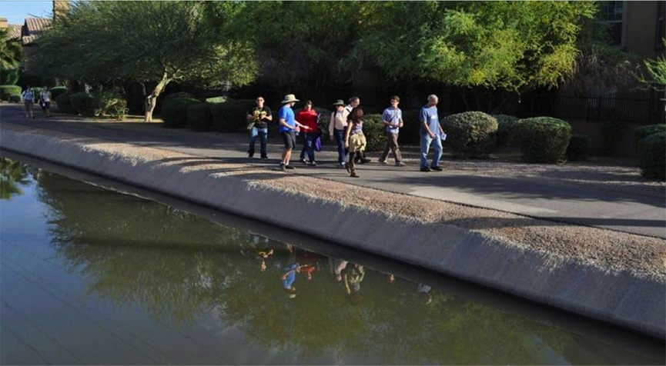
Water – Interaction and Learning Between “Experts” & Citizens

Slide 27
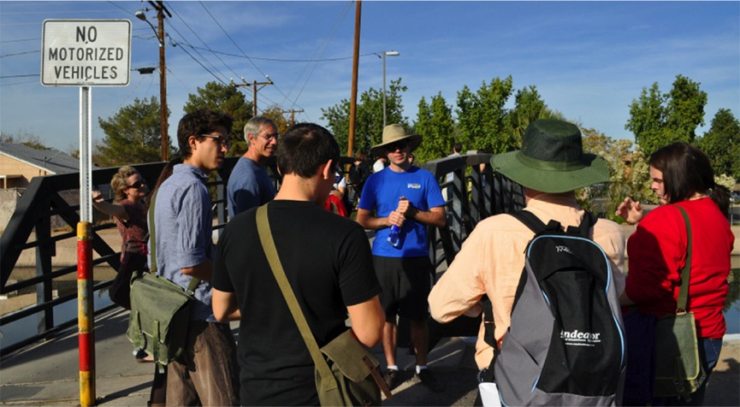

Slide 28
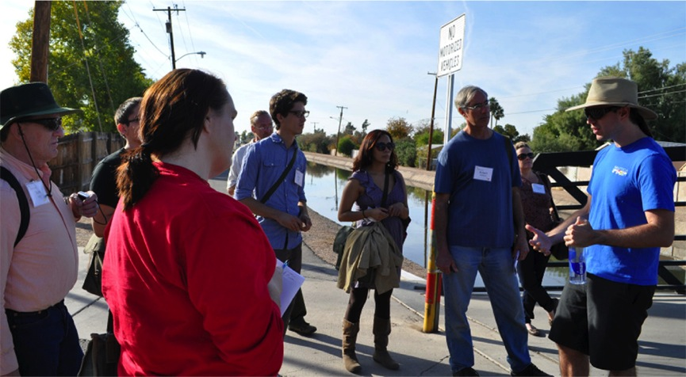

Slide 29
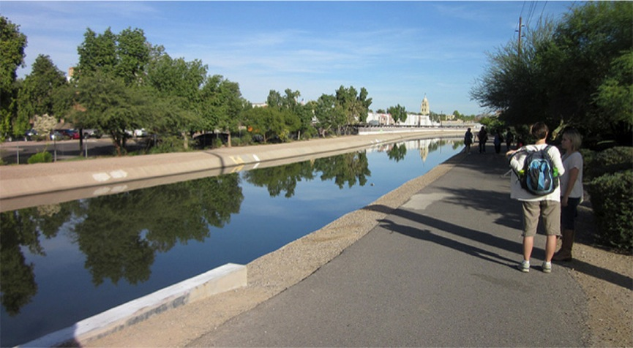
The city’s lifeblood (past)

Slide 30
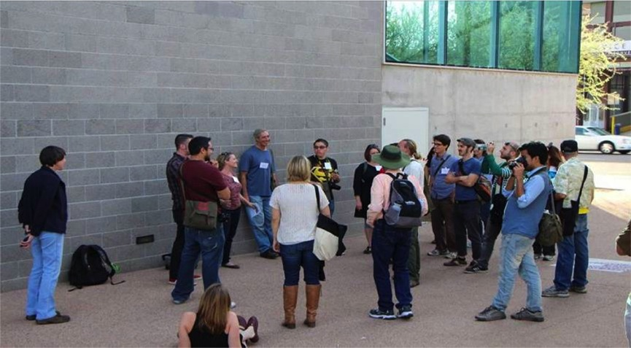
Debriefing

Slide 31
“I was surprised about what I didn’t know about the things I see everyday.”
“I was a tourist in my own city, I was born here, lived here, and yet I haven’t seen a lot of these things.”
“I’m optimistic for us as citizens to solve problems but I’m pessimistic about government’s ability to solve them.”
“To be able to see the interconnectivity of all the systems- to connect them visually and physically.”
“We all have different perspectives- we need to come together to talk.”

